Slide 1
Artwork Image Recognition
Akshaya Chhaban Tonde
Anusha Manchi Satish
Gunjan Sandesh Sureka
Heer Kirtibhai Shah
Sai Preethi Poka

Slide 2


Problem Statement
The process of identifying and labeling artwork images is challenging due to the diversity in artistic styles, textures, patterns, and compositions. Traditional methods often fail to capture the nuanced details of artworks, leading to misclassification and inefficiencies in art cataloging, online galleries, and digital archiving.
This project aims to develop an Artwork Image Recognition System that leverages image segmentation techniques and deep learning models to accurately predict labels corresponding to artwork images. The system seeks to address the challenges of variability in visual features, enabling better categorization, accessibility, and scalability for real-world use cases such as art preservation, e-commerce, and educational platforms.

Slide 3



Proposed Solution
Data Preprocessing
Resize images and split them into training, validation, and testing datasets.
Training and Fine-Tuning
Freeze pre-trained model layers to preserve learned representations.
Add custom layers
Optimize with Adam optimizer and
cross-entropy loss for robust learning.
Deep Learning Models
Implement and evaluate three state-of-the-art architectures:
Evaluation Metrics
Use accuracy and segmentation visualizations to assess model performance.
Compare results across models to identify the best-performing approach.

Slide 4




Data Presentation
DATASET LINK :- https://www.kaggle.com/datasets/cyanex1702/surreal-symphonies-a-dataset-of-diverse-art
Images : 7315
Classes : 30
Types of classes: Minimalism, Pop, Romanticism, Symbolism, Digital, Mannerism, Neoclassical, Academic, Impressionism, Baroque, Expressionism, Realism, Surreal, Constructivism, Contemporary, Gothic, Renaissance, Cubism, Abstract, Naïve, Modernism, Pre-Raphaelite, Dadaism

Slide 5
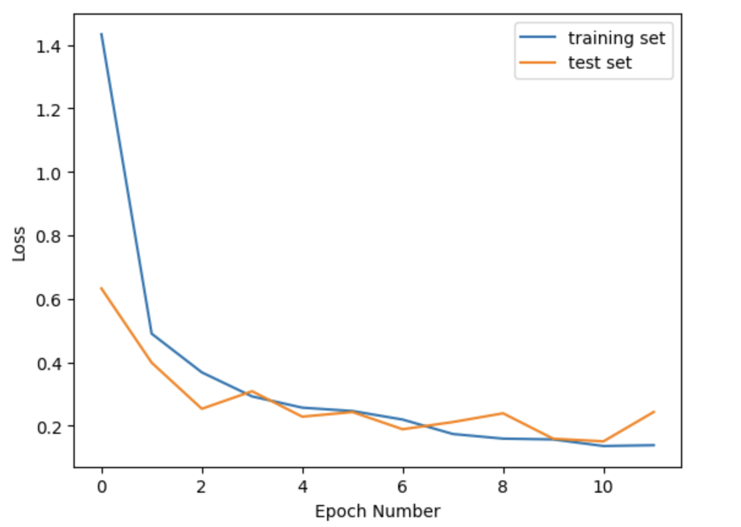
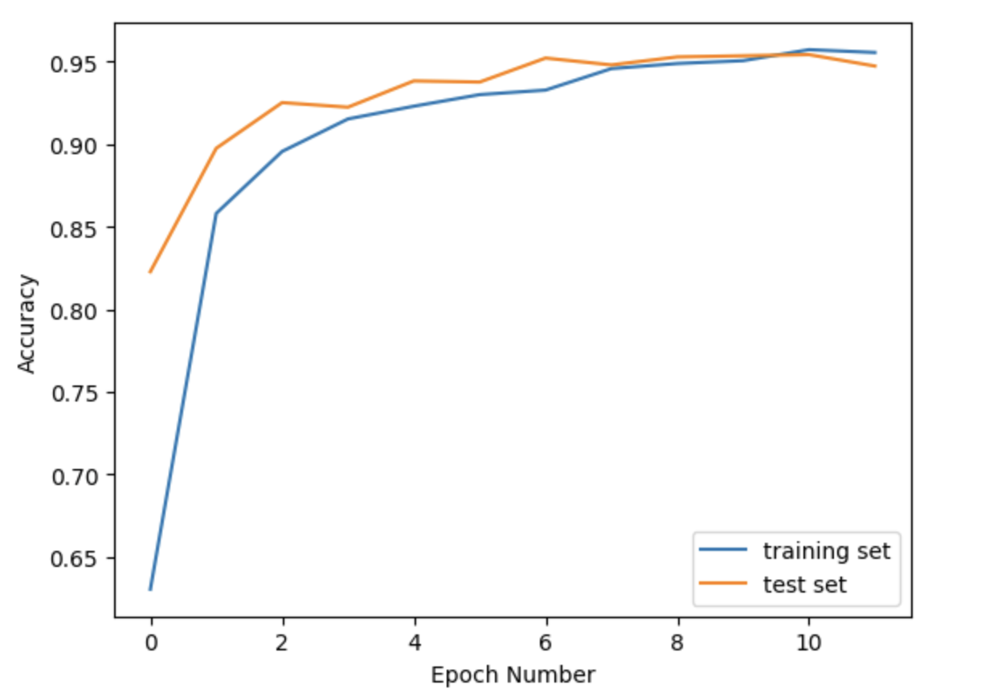
Data Visualization

Slide 6
Model Development
ResNet152v2 - A deep residual network designed to capture multi-scale features and prevent vanishing gradients for superior accuracy.
The pre-trained VGG16 model is imported using tensorflow.keras.applications with weights set to 'imagenet' and the fully connected layers excluded (include_top=False). The input shape and pooling type are defined as img_shape and 'avg', respectively.
The pre-trained model's layers are then frozen by setting their trainable attribute to False, ensuring the pre-trained weights remain unchanged during training.
Custom layers are added on top of the base model to tailor it for the specific classification task. A batch normalization layer is included to normalize activations, followed by a fully connected layer with 1024 units and ReLU activation. Dropout is applied with a rate of 0.2 to mitigate overfitting. The final dense layer, equipped with num_classes units and softmax activation, serves as the output layer for classification.
The complete model is built by defining the pre-trained model's input as the input layer and the predictions from the custom layers as the output layer. The model is compiled using the Adam optimizer with a learning rate of 0.001, 'categorical_crossentropy' as the loss function for multi-class classification, and 'accuracy' as the evaluation metric.

Slide 7
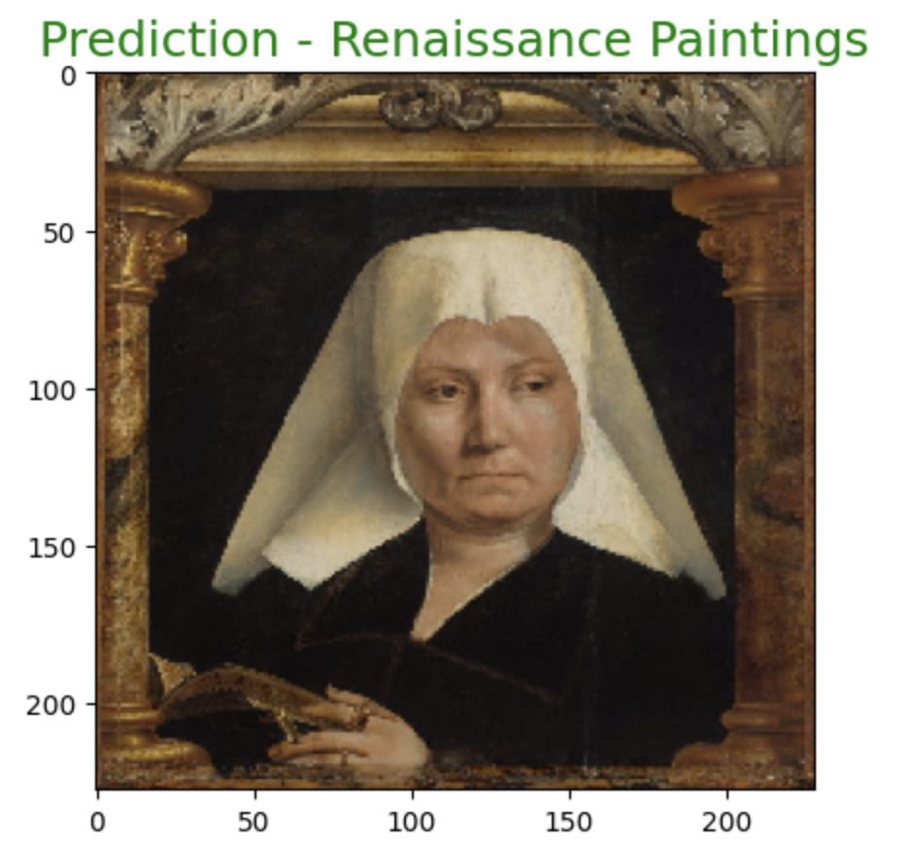
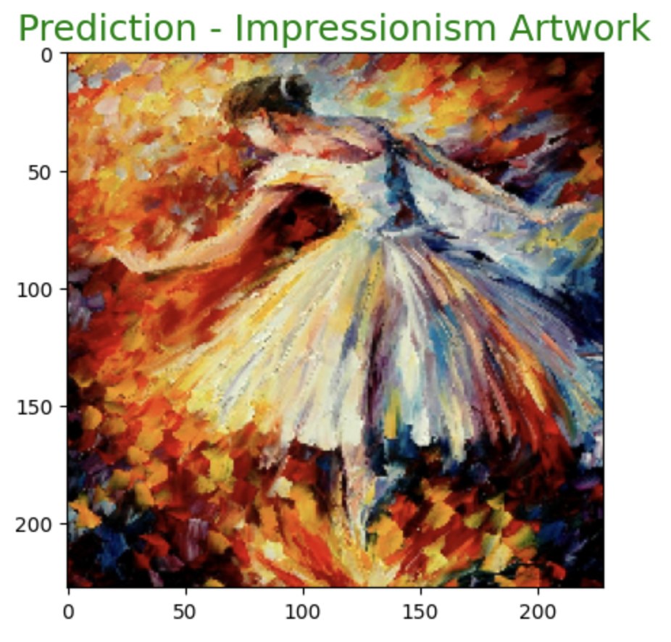
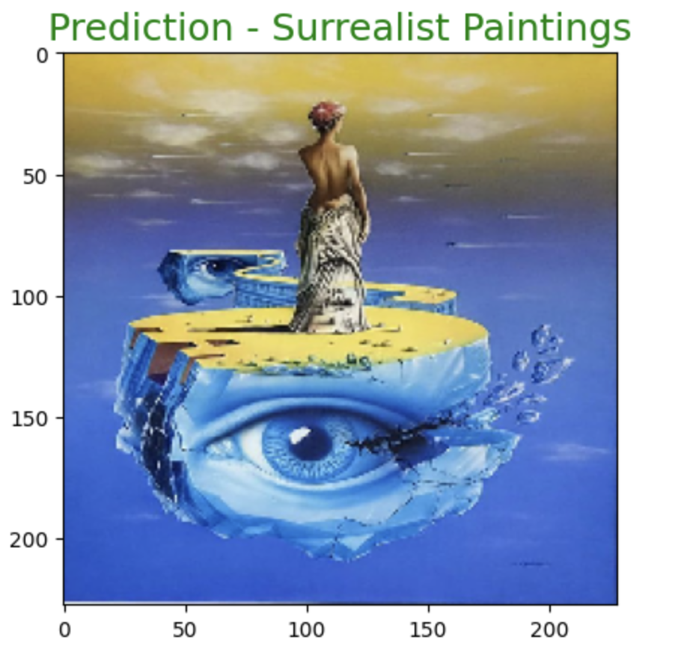
Image Recognition Results
Correctly classified Images

Slide 8
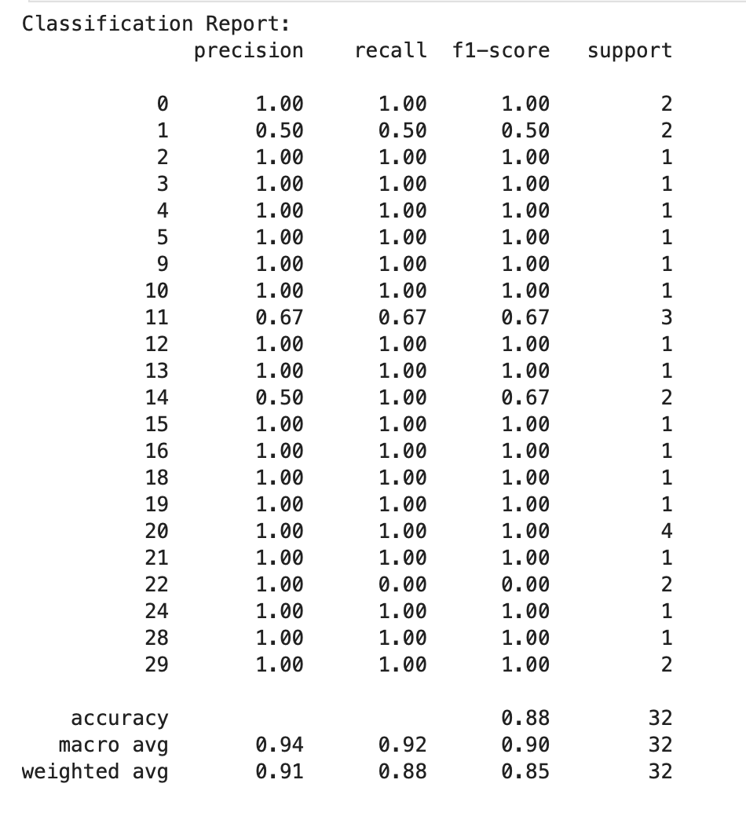
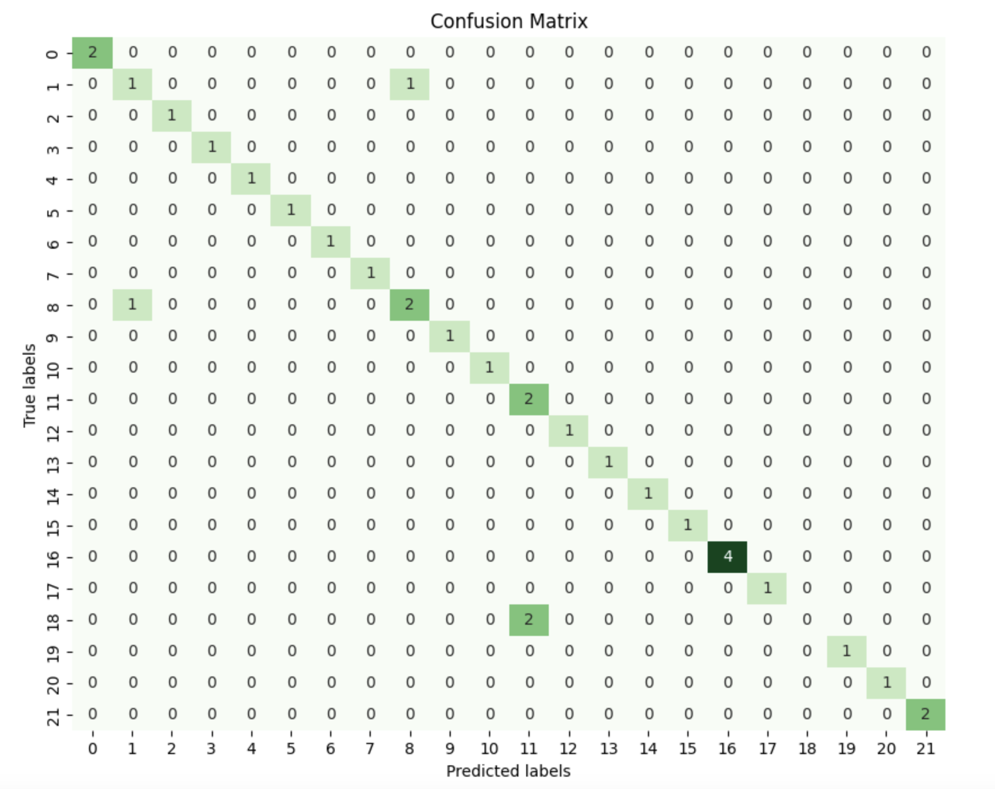
Evaluation Metrics
Accuracy score : 87.5%

Slide 9


Future Scope
Model Improvements:
Fine-tune ResNet152V2
Explore model ensembles for better accuracy
Test new architectures (e.g., EfficientNet)
Dataset Expansion:
Add more art styles and periods
Enable user-contributed data for continuous learning
Applications:
Museum and art platform integrations
Educational tools for art history exploration

Slide 10







AI-Based Book Recommendation System

Slide 11




Why we selected this data?
Purpose: To create a personalized book recommendation engine using advanced AI and machine learning techniques.
Significance: Enhances the reading experience by providing tailored book suggestions.
Solves the problem of overwhelming book choices, making it easier for users to discover new content they are likely to enjoy.
Scope: Implements both collaborative and content-based filtering methods to generate accurate and relevant book recommendations.
Notes:
Readers often struggle to find books that align with their tastes.
Traditional recommendations, like those based on bestseller lists, don’t consider personal preferences.

Slide 12


Problem Description
With the vast number of books available today, readers often face decision fatigue. A personalized recommendation system helps narrow down choices by understanding and predicting user preferences.
Objective:
Develop a system that efficiently recommends books based on user history and book features.
Increase user engagement on book discovery platforms.
Notes:
Our system bridges this gap using content-based filtering and collaborative filtering,
leveraging book features and user behavior to deliver highly relevant suggestions

Slide 13

Dataset
Curated from Goodreads and hosted on Kaggle.
Volume: 100,000 unique book entries with a diverse range of features.
Features Detailed:
Title & Author: Fundamental book metadata.
Average Rating & Rating Count: Measures of reader satisfaction and engagement.
Genres: Textual and categorical data denoting literary themes.
Number of Pages: Proxy for book length and complexity.
Publication Year: Temporal aspect for trend analysis.

Slide 14
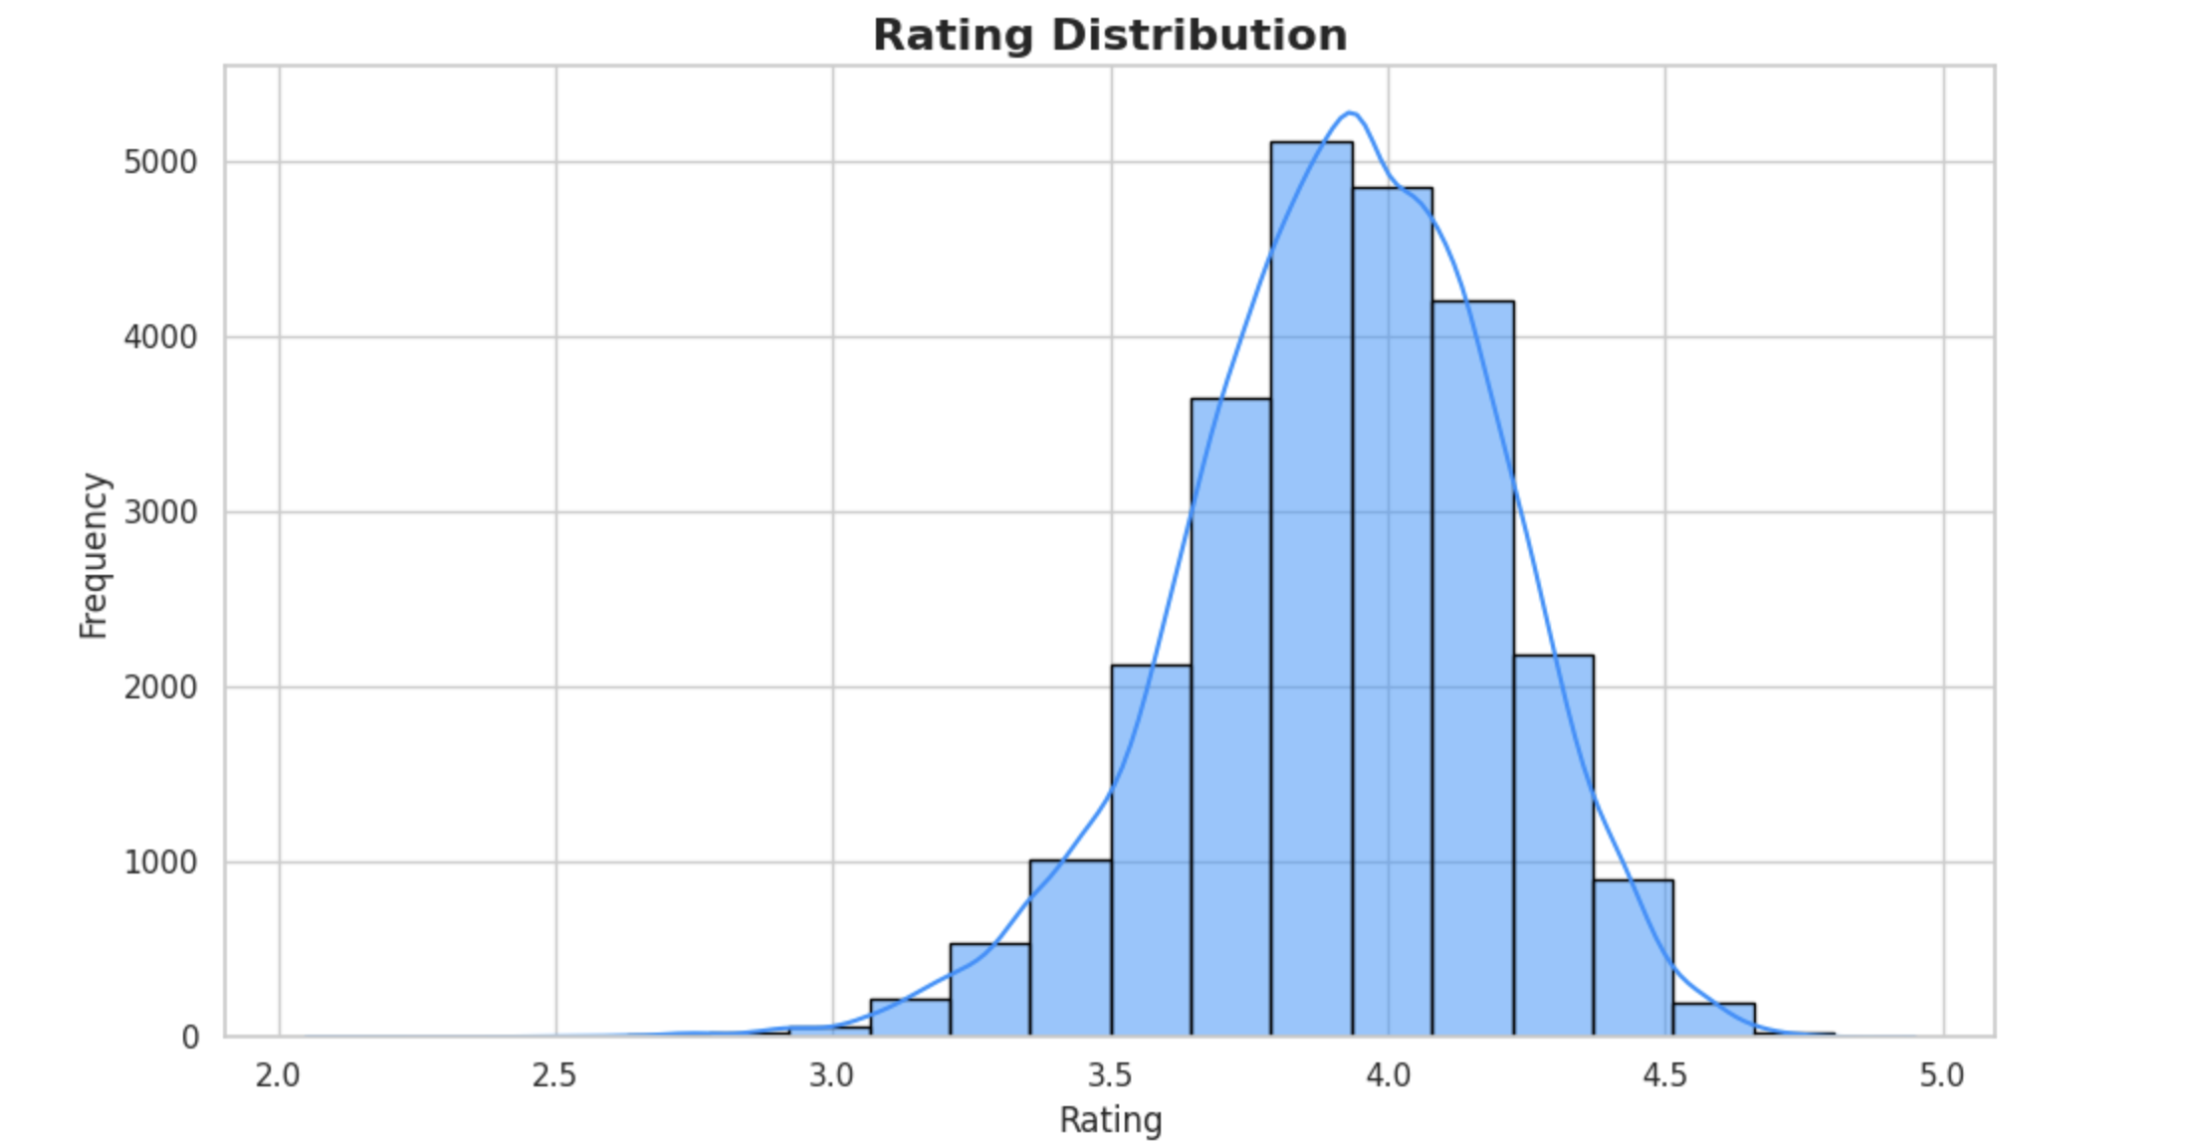
Data Visualization
Notes:
Central Rating Range:
Highlight that the majority of books are rated between 3.5 and 4.0, showing a positive trend in user ratings.
Emphasize that users generally lean toward moderate to high ratings.
Balanced Distribution:
Point out the bell-shaped curve (normal distribution), which indicates fairness and uniformity in how books are rated across the dataset.
KDE Curve for Insights:
Discuss the Kernel Density Estimate (KDE) line overlay, which provides a smooth approximation of the rating trends, ensuring the dataset avoids extreme bias (e.g., predominantly low or high ratings).

Slide 15
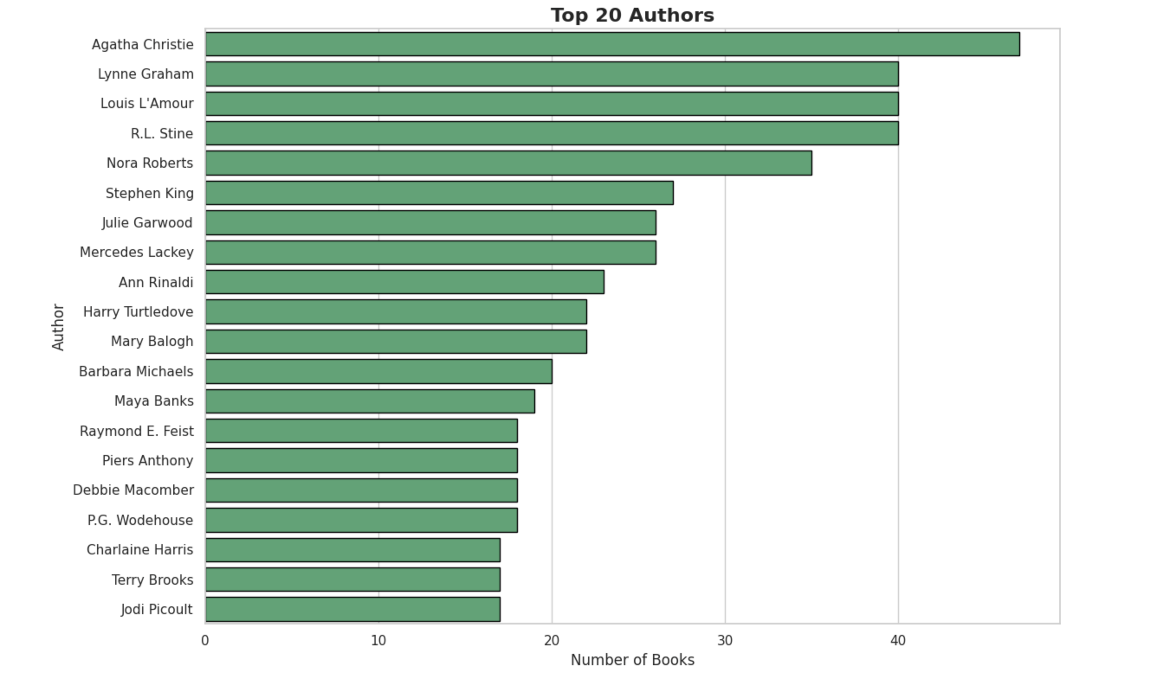
Data Visualization
Notes:
Agatha Christie’s Dominance:
Highlight that Agatha Christie is the most represented author, reflecting her global appeal and extensive body of work in the mystery genre.
Genre Versatility:
Explain the range of authors, including R.L. Stine (children's horror), Stephen King (horror and thriller), and Nora Roberts (romance), showcasing the dataset's coverage of multiple genres.

Slide 16
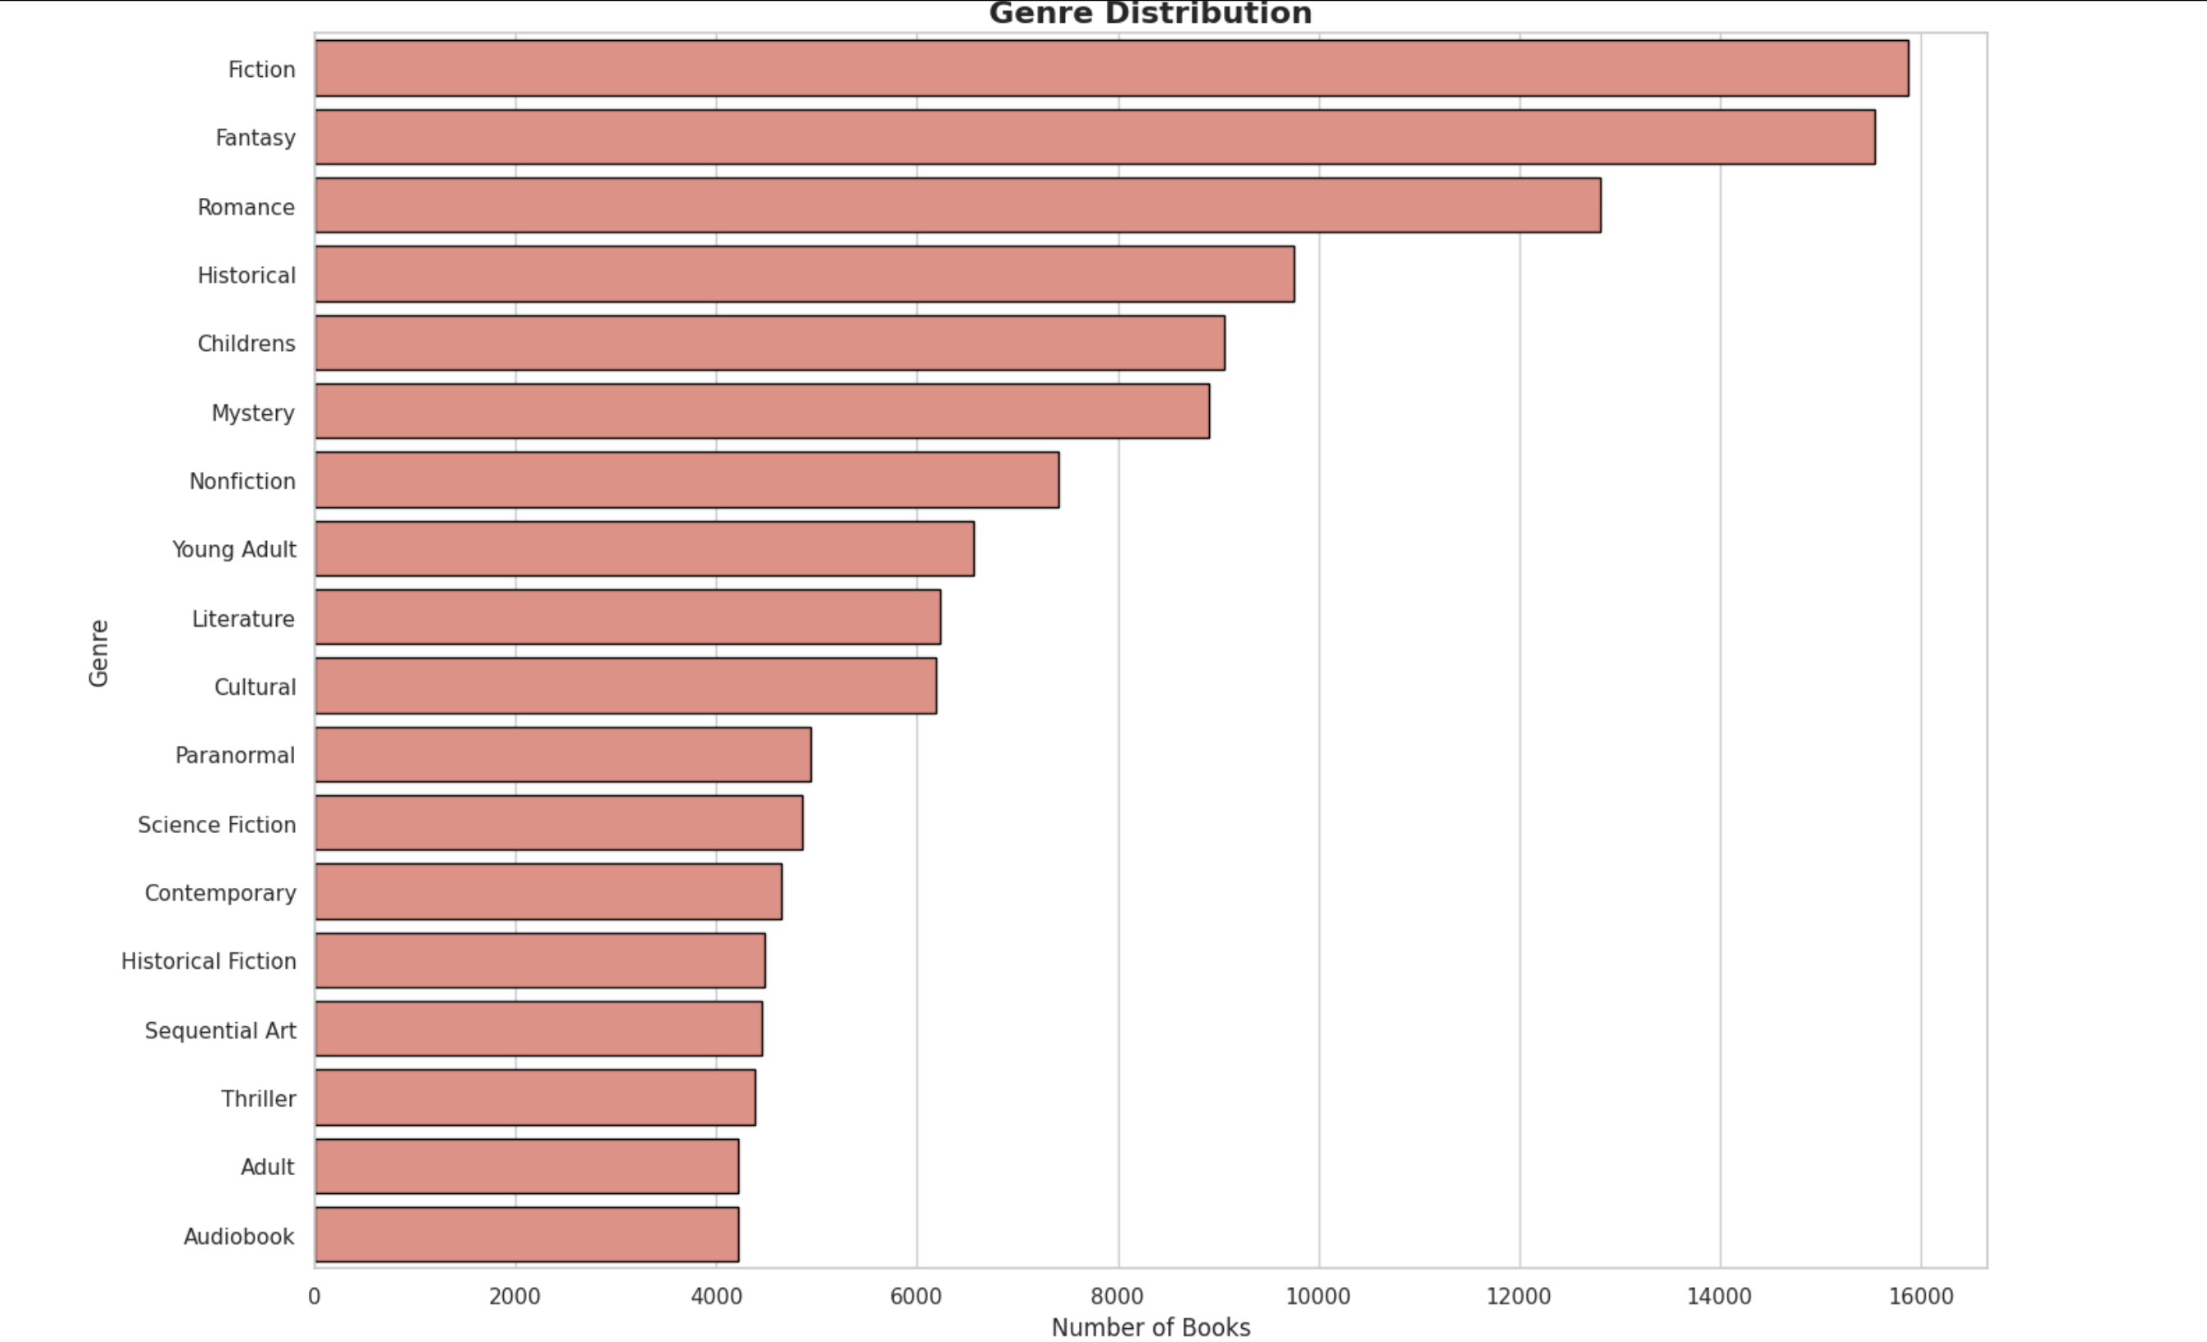
Data Visualization
Notes:
Dominance of Fiction and Fantasy:
Emphasize that Fiction and Fantasy dominate the dataset, with nearly 16,000 books each, catering to the most popular reader preferences.
Broad Genre Representation:
Highlight the dataset’s diversity, with genres like Nonfiction, Historical Fiction, and Young Adult offering something for every type of reader.
Impact on Recommendations:
Explain how the genre distribution allows the system to provide varied recommendations, catering to niche interests like Paranormal or Sequential Art, while still supporting mainstream categories.

Slide 17



Model Development
User-Based Collaborative Filtering Code Highlights:
A user-book matrix was created with user IDs as rows and book titles as columns.
KNN was used to identify similar users based on cosine similarity.
Recommendations were generated by aggregating and sorting the ratings of books rated by similar users.
Content-Based Filtering Code Highlights:
Data was preprocessed to encode categorical features and normalize numerical features.
KNN identified books similar to the input based on selected features.
Recommendations included detailed descriptions and visualizations.
Notes:
User Based Collaborative Filtering: This recommendation approach finds books for a target user (user_id) by identifying other users with similar tastes based on their book ratings.
K-Nearest Neighbors (KNN) model used to identify similar user and item patterns.
Cosine Similarity measures how closely two users' ratings align, regardless of the absolute values.
Content Based Filtering: This approach identifies books that are similar to a given book title.
K-Nearest Neighbors (KNN) model is trained using Euclidean distance to calculate feature similarity.

Slide 18
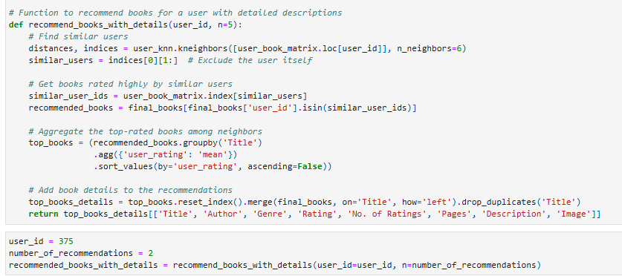

Results
User-Based Collaborative Filtering

Slide 19
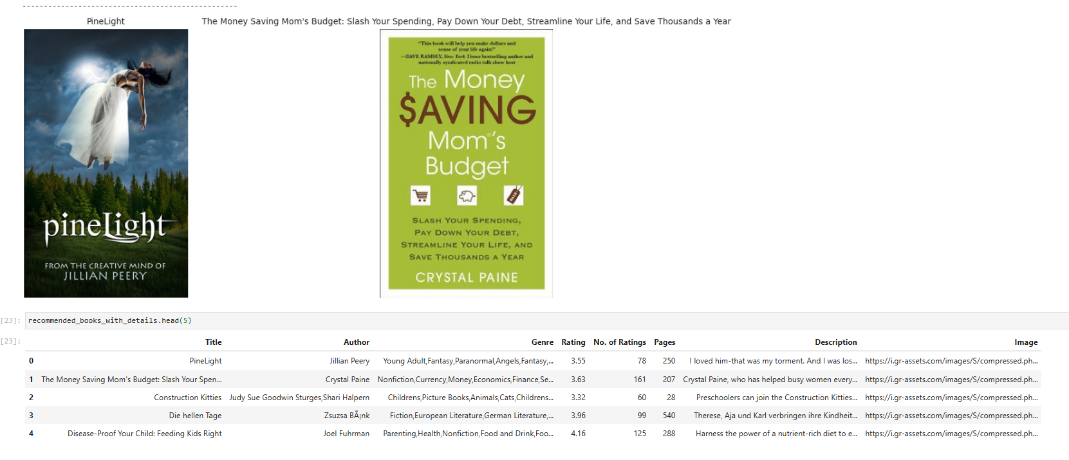
Results
Notes:
The system looks at patterns in how users rate or interact with books.
2. For instance, if User A and User B have rated several books similarly, the system assumes they have similar preferences and recommends books User A has read to User B, and vice versa

Slide 20
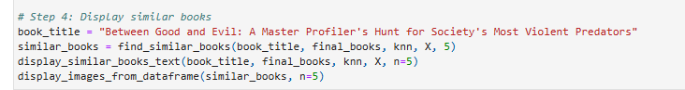
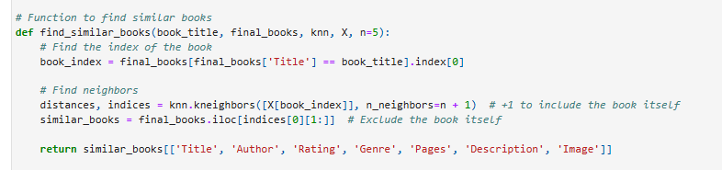
Results
Content-based filtering Input

Slide 21
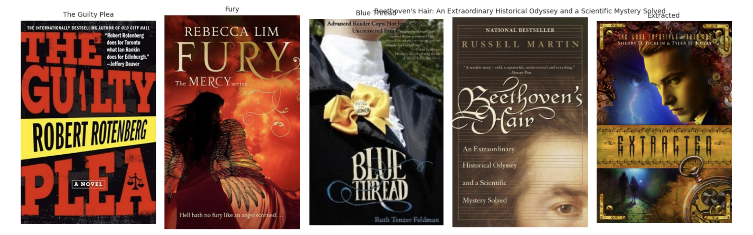
Results
Output Display similar books:
Notes:
When a user provides a favorite book, the system identifies similar books by comparing features using algorithms like cosine similarity.
2. For example, if you love a mystery novel with a psychological twist, the system finds other books that match these elements, ensuring relevance.

Slide 22
Conclusion
The book recommendation system successfully combines Collaborative Filtering and Content-Based Filtering to provide tailored book suggestions. Each approach caters to different use cases:
Collaborative Filtering identifies personalized recommendations based on user interactions.
Content-based filtering finds books similar to a user-provided title using feature similarity.
Key Benefits:
Delivers personalized recommendations that adapt to user preferences.
Supports content-based exploration for users seeking similar books.
Provides visual and textual details to enrich the recommendation experience.
Notes:
The final output is simple and user-friendly.
Users can input a favorite book or genre.
2. The system provides a list of recommended books, complete with titles, authors, ratings, and even cover images.
3. For example, if you enjoy ‘The Silent Patient,’ the system might suggest books like ‘The Girl on the Train’ or ‘Behind Closed Doors. By leveraging content-based and collaborative filtering alongside rich metadata, we ensure that every suggestion is thoughtful, personalized, and relevant

Slide 23
Future Work
Develop a hybrid model combining collaborative and content-based approaches for improved accuracy.
Integrate real-time updates to account for new user ratings and books.
Add sentiment analysis to analyze book reviews and refine recommendations.
Create an intuitive user interface for seamless interaction and better user experience.
Notes:
The final output is simple and user-friendly.
Users can input a favorite book or genre.
2. The system provides a list of recommended books, complete with titles, authors, ratings, and even cover images.
3. For example, if you enjoy ‘The Silent Patient,’ the system might suggest books like ‘The Girl on the Train’ or ‘Behind Closed Doors. By leveraging content-based and collaborative filtering alongside rich metadata, we ensure that every suggestion is thoughtful, personalized, and relevant

Slide 24



THANK YOU!

